Slide 1
Exploratory data analysis of Olympics ‘21
KNOWLEDGE DISCOVERY IN DATABASES-FALL’21
Group 6
TEAM MEMBERS
Ouchithya Bollu Karthikeyan Mehalingam
Gowri Alwarsamy
Sai RaviRaj NELANUTHALA
Vaishnavi Mahesha

Slide 2
Introduction
Olympics is one of the most prestigious sports event where more than 200 countries participate and compete.
The purpose of our project is to perform visualization and Exploratory Data Analysis on the dataset.
We will perform correlations among the athletes, coaches, gender, medal, and teams participated in olympics’21 to obtain interesting patterns.
We are using ‘2021 Olympics in Tokyo’ Dataset.
Dataset-’https://github.com/kdd-group-6/KDD-group-6-project/tree/main/dataset’.

Slide 3
About the Data
Source of the Dataset- Kaggle
The Dataset taken had to be preprocessed and cleaned before it was use.
Dataset contains- Data about 11,000 athletes in 47 disciplines, along with 743 Teams.
This dataset contains the details of the Participants, Teams, and Coaches participating.
It has details such as names, discipline, gender of competitors, countries they represent, and the name of their coaches.
The dataset also contains details regarding the medals tally of each Team /Country.

Slide 4
CRISP - DM Process:
The six steps in the CRISP-DM process are:
Business Understanding
Data Understanding
Data Preparation
Data Modeling
Evaluation
Deployment

Slide 5
Research Questions
We had 5 research question which we wanted to get insights about.
Which country has the highest number of participants in Olympics 2021 overall?
Which country has the highest number of participants in each sport in Olympics 2021?
Which gender has more participation in a given sport?
Countries and number of gold, silver and bronze medals?
Which country has the highest number of coaches?

Slide 6
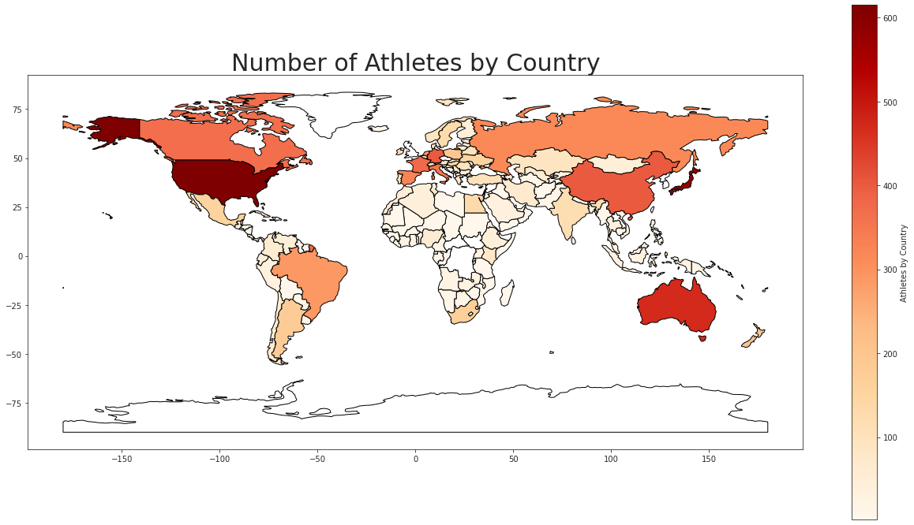
Research Question 1 Data Exploration: Countries vs Number of Participants.
Aim- to find No of athletes per country.
Result-
Using world Map plot
Colors indicate the concentration of players per country.
Insights-
The highest number of players came from – United States of America, Japan and Australia.(Dark Red Parts)
Least number of athletes came from- Greenland, Antarctica, South Korea(White parts)

Slide 7
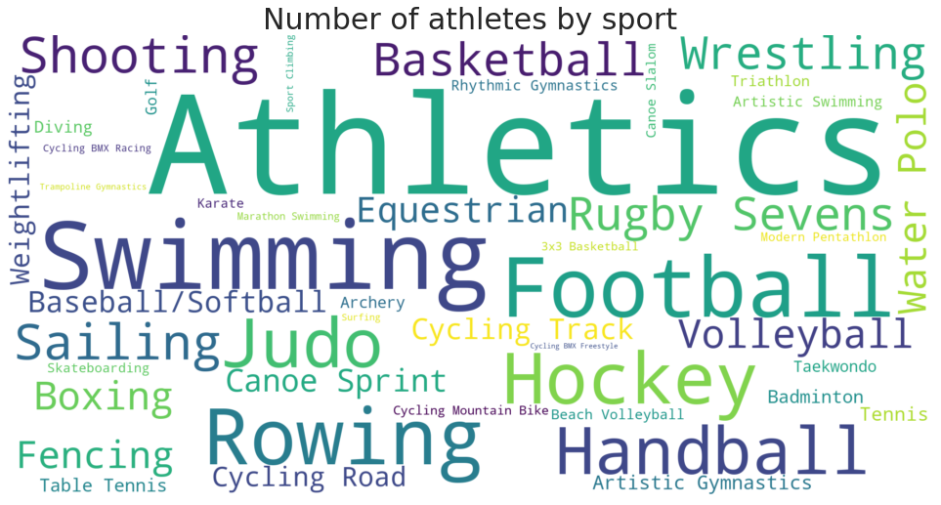
Research Question 2 Data Exploration: Sports and no of participants
Aim- to find No of athletes per Sport
Result-
Using Word Cloud Plot
Size of the word indicate the number of players per sport.
Insights-
The highest number of athletes are for – Athletics, Swimming(Words with large Font Size)
Least number of athletes are for – Trampoline gymnastics, 3x3 basketball etc.,(Words with least font size)

Slide 8
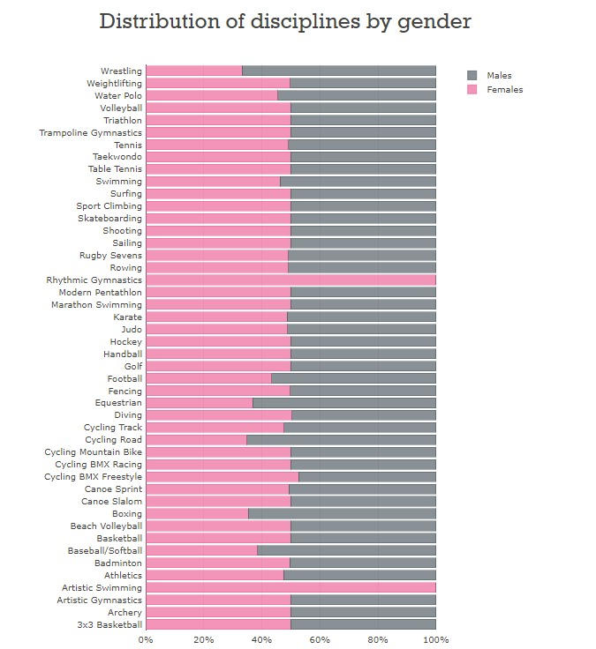
Research Question 3 Data Exploration: women & men Ratio of participants in sports
Aim- to find ratio of men and women participants per Sport
Result-
Using Stacked bar plot 1
Color indicate the ratio of men and Women. [pink- Women, grey- Men]
Insights-
The highest number of women athletes are for – Rhythmic Gymnastics and Artistic Swimming.
The highest number of men athletes are for- Wrestling and Road cycling.

Slide 9
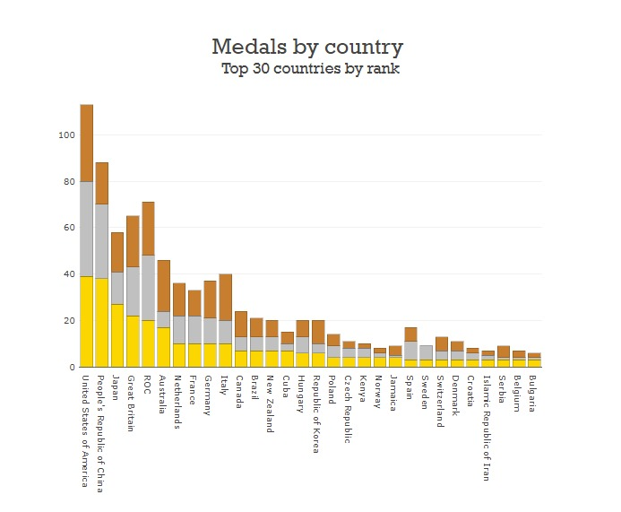
Research Question 4 Data Exploration: Country and no. of gold/silver/bronze medals:
Aim- to find country with highest and lowest no of medals
Result-
Using Stacked bar plot 2
Color indicate Gold, Silver and Bronze metals, Height of bar indicates total no of medals.
Insights-
The highest number of medals are won by – United states of America
Lowest number of medals are won by - Bulgaria.

Slide 10
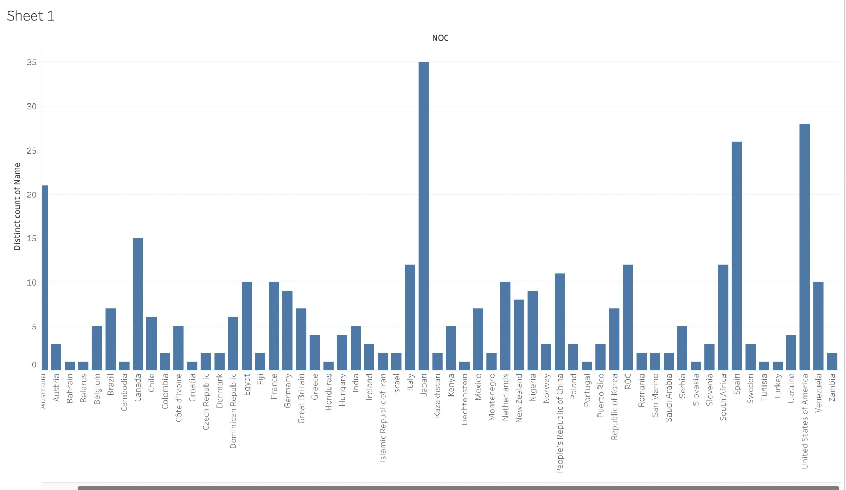
Research Question 5 Data Exploration: no of Coaches per Country
Aim- to find country with highest and lowest no of coaches.
Result-
Using Bar plot
Height of bar indicates total no of coaches per country.
Insights-
The highest number of coaches are for – Italy
Lowest number of coaches are for – Portugal, Turkey etc.,

Slide 11
Conclusion
The insights from Data exploration helps in better Decision making.
All the data had to be cleaned, standardized and merged.
Proper visualization techniques and charts are used to get proper insights out of the data.
No additional features were not created for the EDA process.
Some charts were created using a python notebook and some were done using Tableau

Slide 12
Future Scope
This analysis along with previous Olympics data can be used for
future prediction of the participation of countries’
analyze the growth of the countries athletes.
to strategize and improve the performance of a particular country.
Moreover, by doing so we can improve the quality and experience of the Olympic games.

Slide 13
Thank You ☺!

